Slide 1



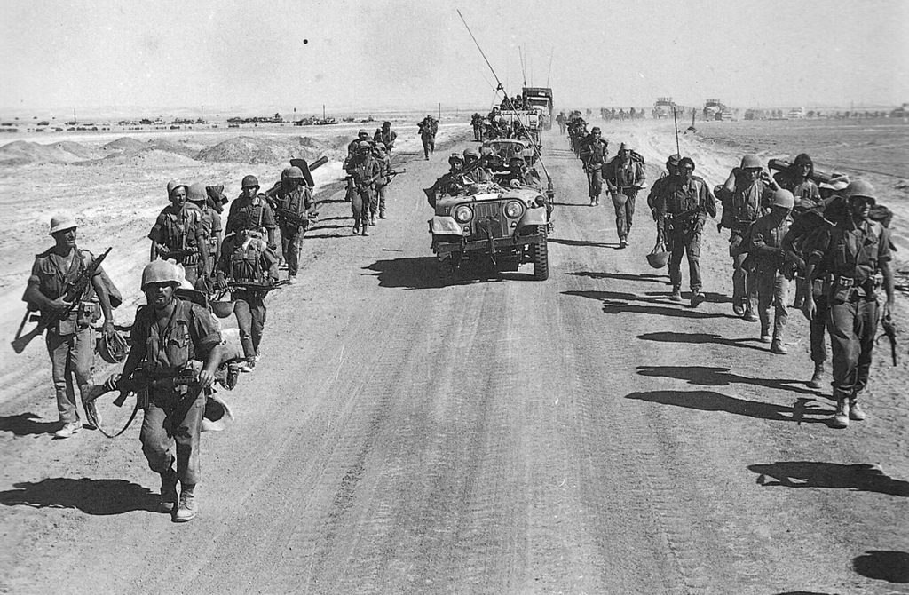
YOM KIPPUR WAR
Intelligence Failures and Mitigating the Influence of Cognitive Biases
סדנא-1

Slide 2
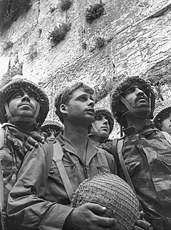
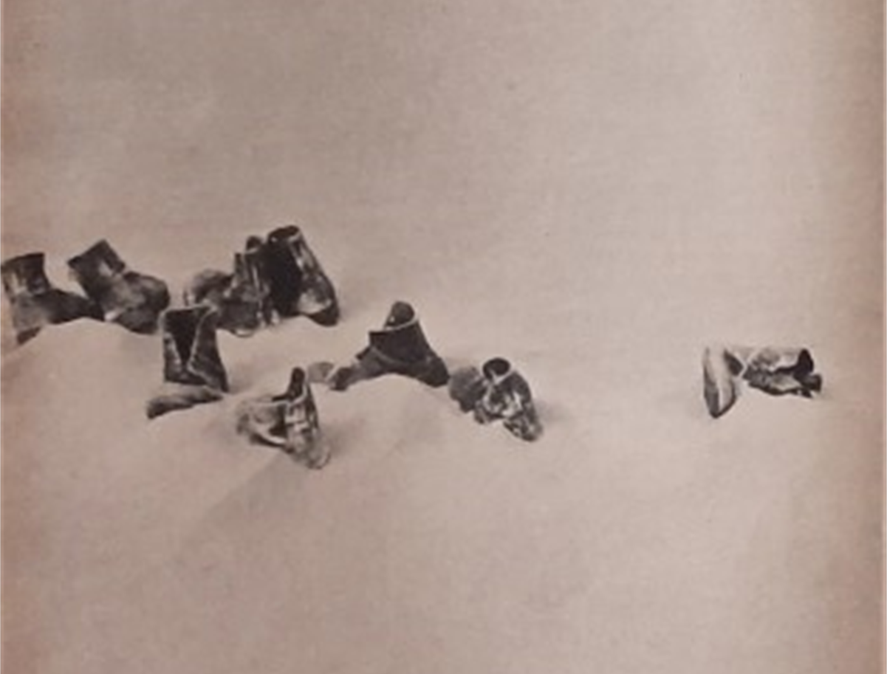
What is the most significant image for understanding the Yom Kippur War?

Slide 3
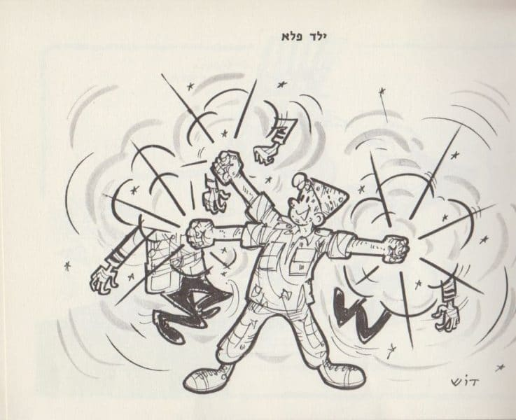
"The IDF proved on three fronts that its effectiveness transcends all borders", a cartoon by Dosh from the book "Sorry We Won”"

Slide 4
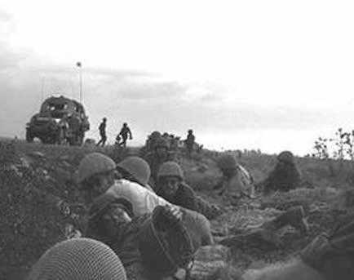
The Yom Kippur War –
י' תשרי תשל"ד 10.6.1973, :
The background to the war:
The picture of the soldiers at the Western Wall symbolizes the victory
but
The image of the shoes and the cartoon symbolize the feeling of superiority and caused disdain and an excessive sense of security that caused the concept to be accepted.
What is the concept?
The concept: a wrong worldview The basic premise was that Egypt, even though it had a skilled army with innovative weapons and high capabilities, would not attack until it had the ability to neutralize the air superiority of the Israeli Air Force, and that Syria would not attack without Egypt due to its military weakness.​

Slide 5
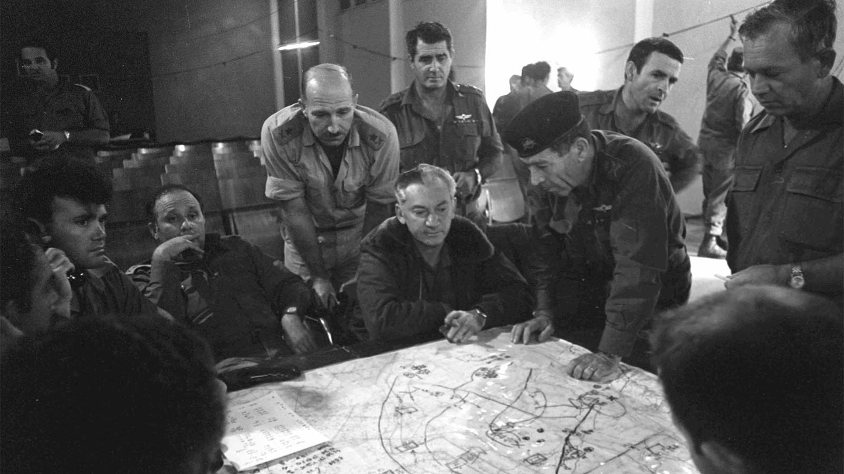
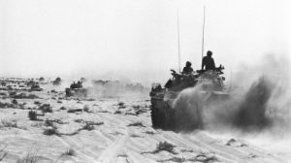
Actually -Intelligence reports and many signs on the ground indicated an impending war
But
Because they were so caught up in the concept, and did not believe that war would break out, the sirens that went off in the middle of Yom Kippur at 2PM came as a complete surprise

Slide 6

In addition to the fact that the decision makers fell for misconception, there were also some
Cognitive biases
that influenced the intelligence officers and decision makers.
What are those cognitive biases?
During the game we will understand...

Slide 7
Matching Game

Slide 8

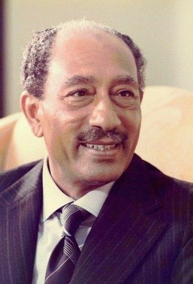
the real explanation
an excuse based on the concept
the actual event
Sadat was determined to execute a military operation to capture territory lost by Egypt in the Six Day War. He convinced Syria to partner with him. He ordered his generals to prepare battle plans to capture the Sinai or at least a large part of it to shock Israel.
Anwar Sadat was perceived
as a weak leader.
This added to Israel’s
feeling of security.
the type of cognitive bias
Recency Bias causes humans to disproportionately rely on recent and readily available information when making decisions. Sadat was viewed as a hesitant leader. Israel relied on this assessment and did not test this assumption.
In September 1970
Gamal Abdel Nasser,
president of Egypt, died.
Anwar Sadat was appointed
the new president.

Slide 9
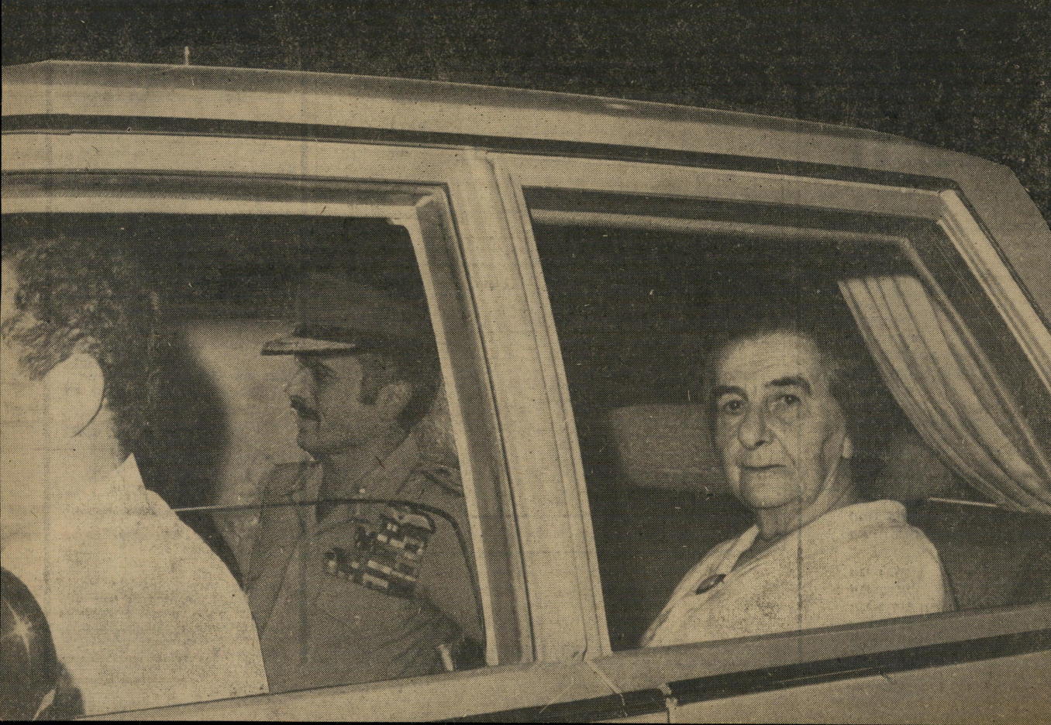
the real explanation
an excuse based on the concept
the actual event
King Hussein’s information
was correct.
Moshe Dayan and Eli Zeira calmed Golda Meir and claimed that the warning King Huissein delivered was based on a faulty source.
On September 25, 1973
King Hussein of Jordan met secretly with Golda Meir in a very urgent meeting.
Hussein reported that the Egyptians and Syrians were preparing to attack Israel
and that he declined to join them.
Golda Meir passed this information to the defense minister, Moshe Dayan, and to the head of military intelligence,
Major General eli Zeira.
the type of cognitive bias
Disconfirmation Bias: This manifests itself by dismissing evidence that contradicts
one’s beliefs.
Dayan and Zeira fell victim to this bias and thus dismissed Hussein’s warning.
.
.

Slide 10

Conclusions
All these biases and the concept had a decisive influence on the initial decisions of the Israeli leadership, before and at the beginning of the war.
Before the war, the political leadership and the citizens of Israel felt that the IDF was an invincible army, and that the next war was supposed to be the "seventh day" of the Six Day War.
Everyone thought that the Arabs were militarily inferior to Israel in many ways and that any war that Israel embarked on would end in a crushing victory over the Arab countries.
The Yom Kippur War was a supreme test of this thought.
The war did end with a victory manifested in the IDF's advance up to 35 kilometers from Damascus, that is, within the range of the IDF's artillery, and in Sinai with a very severe hit to the Egyptian anti-aircraft system (anti-aircraft defense), and an advance up to 99 kilometers from Cairo,
But the horror of the surprise and the many casualties, and more so the realization that we were very close to defeat, did not let go of the public opinion in Israel and it understood that in a war each side suffers its losses, and these may be large and bitter.

